Slide 1
Jermyn Borough Council Meeting
5/18/2023

Slide 2
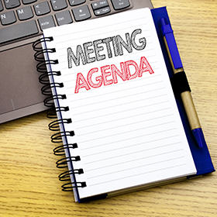
Meeting Agenda
MAY 19, 2023
CALL TO ORDER
PLEDGE OF ALLEGIANCE
ROLL CALL
PREVIOUS MEETING MINUTES
TREASURER REPORT/BILLS PAYABLE
SECRETARY REPORT
CORRESPONDENCE
PUBLIC COMMMENT
PROFESSIONAL REPORTS
POLICE
FIRE
SOLICITOR
CODE ENFORCEMENT
ZONING
ENGINEER
TAX COLLECTOR
MAYOR
COMMITTEE REPORTS
SAFETY
PLANNING
FINANCE
SHADE TREE
REC
MS4
DPW
PAVE CUT ORDINANCE REVIEW
WOODLANDS SEWER PROJECT
DPW GARAGE FLOOR
RIVERVIEW WINERY REQUEST
BRIDGE STREET PARKING ORDINANCE
EXECUTIVE SESSION-PERSONNEL/LEGAL MATTERS
OLD BUSINESS
NEW BUSINESS

Slide 3
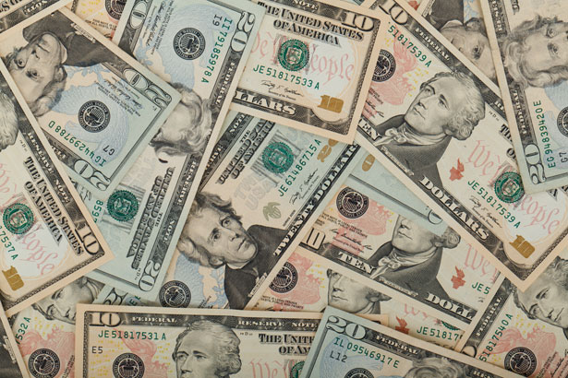
Treasurer’s report
4/20/2023
ASSETS
Checking/Savings
American Rescue Plan Fund 135,713.33
Capital Reserve - DPW 10,728.61
Capital Reserve - Police 5,091.82
Crime Watch Fund 222.69
General Fund - Community 217,656.24
General Fund - FNB 6,550.21
Holiday Lights Fund 1,459.09

Slide 4
Treasurer’s report
Investment - General Fund 1,028.45
Investment - Liquid Fuels 22,644.34
Investment - Paving Fund 1,039.14
Investment - Recycling 113.60
Investment - Refuse 161.97
Liquid Fuels - FNB 58,371.05
Petty Cash 223.00
Recreations Fund 26,661.85
Recycling - Community 1,926.07
Refuse Checking - FNB 178016.29
Total Checking/Savings 667,607.75

Slide 5
Treasurer’s report
200000 · Accounts Payable 15,850.53
Long Term Debt 239,813.15

Slide 6
MS4 Minute
https://youtu.be/jjPfLhJbdc0

